Slide 1


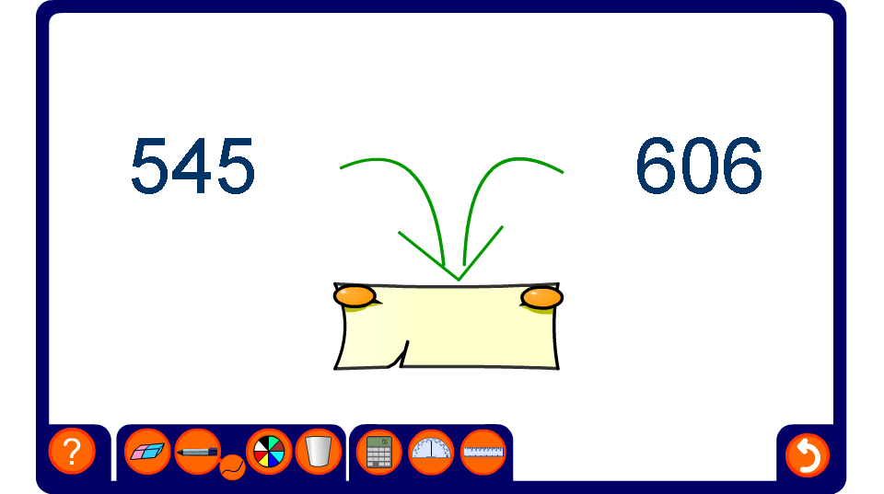


Finding halfway between two numbers
Notes:
Reset to generate different examples. Sometimes it will be the midway number that needs to be found; but on other occasions, this will be given and one of the two endpoints will be hidden.

